Slide 1
Signature Forgery
Andrea Wong

Slide 2
TABLE OF CONTENTS
03
Siamese Networks
01
Problem Statement
04
Modelling
02
Dataset - EDA
05
Summary & Recommendations

Slide 3
Problem Statement
Despite widespread digitalisation in many services(e.g. financial), there are still certain transactions that require the use of signatures as a primary way of authenticating a transaction.

Slide 4
Problem Statement
Laws in singapore requires some documents to be signed physically. This would include documents that determine how individuals' assets would be divided at death, negotiable instruments, power of attorney and real estate transactions.
How are we able to navigate the risks involved with signature forgery?

Slide 5
Problem Statement
I will be exploring the use of neural networks in classifying whether an offline handwritten signature is genuine or forged.
The aim is to limit both type I and Type II errors. Type I error refer to mistakenly identifying a genuine signature wrongly, leading to a negative impact on customer satisfaction. Type II error refers to wrongly identifying a forged signature, leading to financial loss and a negative impact on reputation as well.

Slide 6
Dataset - EDA
Kaggle Dataset
Signatures of Dutch Users extracted from ICDAR 2011 Signature Dataset
Train
Test
Signatures from 64 individuals
-Genuine
-Forgery
Signatures from 21 individuals
-Genuine
-Forgery
-subset of train dataset

Slide 7
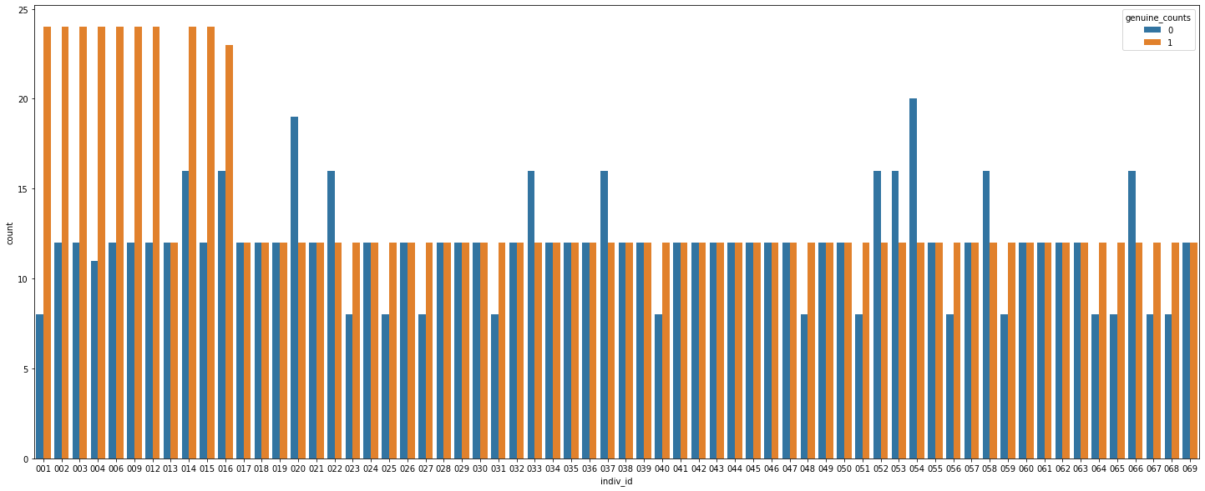
Genuine and Forgery Signatures - Train

Slide 8
Genuine and Forgery Signatures - Train

Slide 9
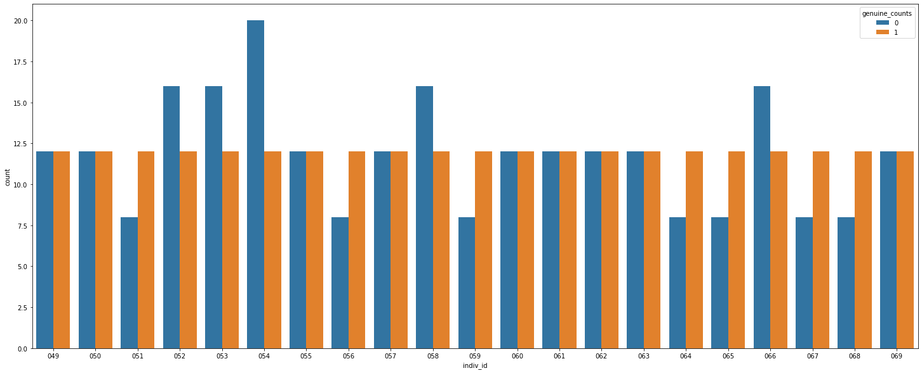
Genuine and Forgery Signatures - Test

Slide 10
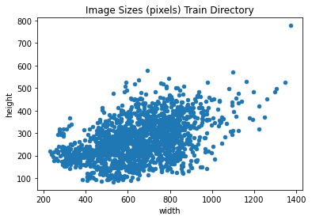
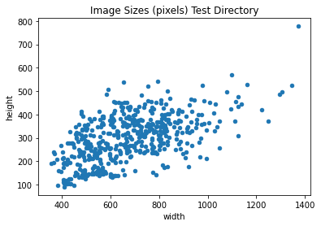
Image Sizes- Test

Slide 11
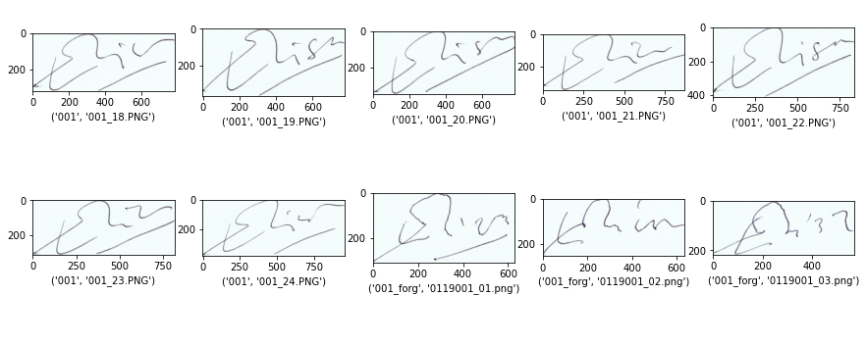
Sample Images
Genuine
Forgery

Slide 12
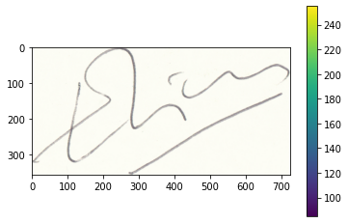
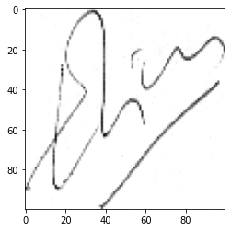
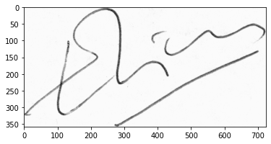
Image PreProcessing
Images were all preprocessed before feeding into the model
Original Sample Image
Color Space Conversion
Resize Image
Normalize Pixel Values
100 * 100
Scales values of the pixels in 0-1 range instead of 0–255
Converting images to grayscale

Slide 13
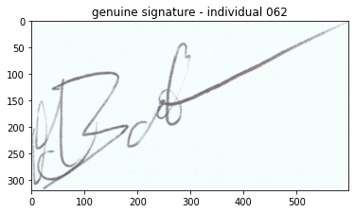
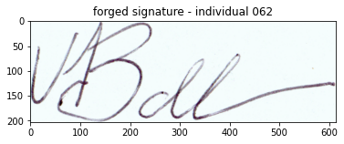
Building Image Pairs
Image pairs were created by mapping each of the genuine signatures by each individual against every other signature by the same individual (genuine + forgery)
Image 1 | Image 2 | Train Label
062/09_062.png | 062_forg/01_0109062.PNG | 1

Slide 14

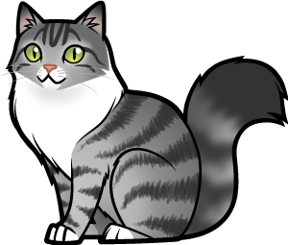
Modelling - Siamese Network
Image encodings
Image 1
CNN
Shared Weights
Euclidean Distance
Output
Are the two images similar or not
CNN
Image 2
two subnetworks have the same architecture and same parameters, and they mirror each other
Image encodings

Slide 15
Modelling - Siamese Network
Image encodings
Image 1
CNN
Shared Weights
Euclidean Distance
Output
Are the two images similar or not
Pros
Fewer data samples required
Can work with highly imbalanced data.
Cons
Time consuming
CNN
Image 2
two subnetworks have the same architecture and same parameters, and they mirror each other
Image encodings

Slide 16
Model Results
Model 1
Accuracy : 0.7262
Model 2
Accuracy : 0.9499
Convolution + Relu
Max Pooling layer
categorical_crossentropy
Convolution + Relu
Max Pooling layer
categorical_crossentropy
BatchNormalization
Drop Out

Slide 17
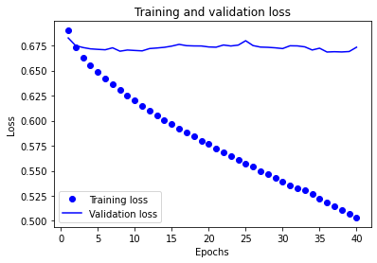
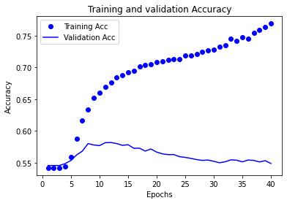
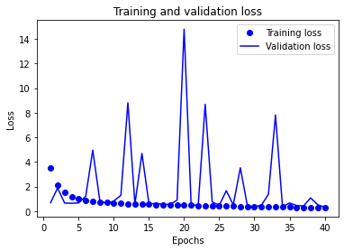
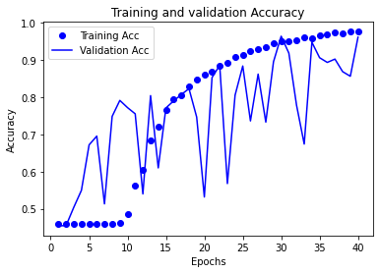
Model Results
Model 1
Accuracy : 0.7262
Model 2
Accuracy : 0.9499

Slide 18
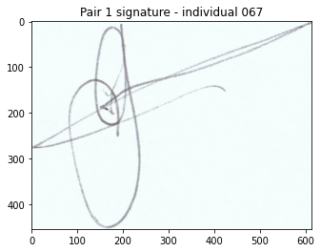
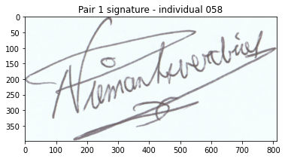
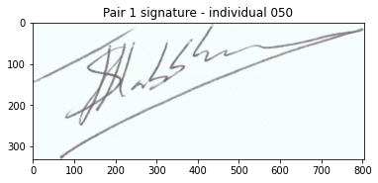
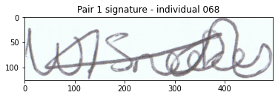
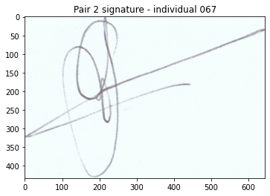
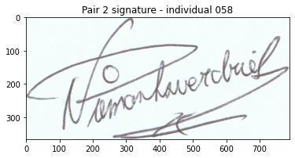
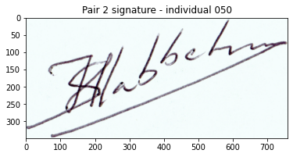
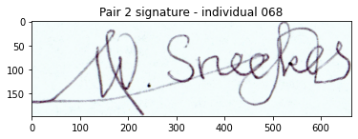
Model Predictions
True label : not similar
True label : similar
True label : similar
True label : not similar
Prediction
Prediction
Prediction
Prediction
Model 1: not similar
Model 2 : not similar
Model 1: similar
Model 2 : similar
Model 1: similar
Model 2 : similar
Model 1: not similar
Model 2 : not similar

Slide 19
Conclusion and Recommendations
Address overfitting ( Data Augmentation, GAN)
Use cases (application of handwritten signatures to e-signatures )
Notes:
increase the amount of data by adding slightly modified copies of already existing data or newly created synthetic data from existing data. It acts as a regularizer and helps reduce overfitting when training a machine learning model.^{[1]} It is closely related to oversampling in data analysis.

Slide 20
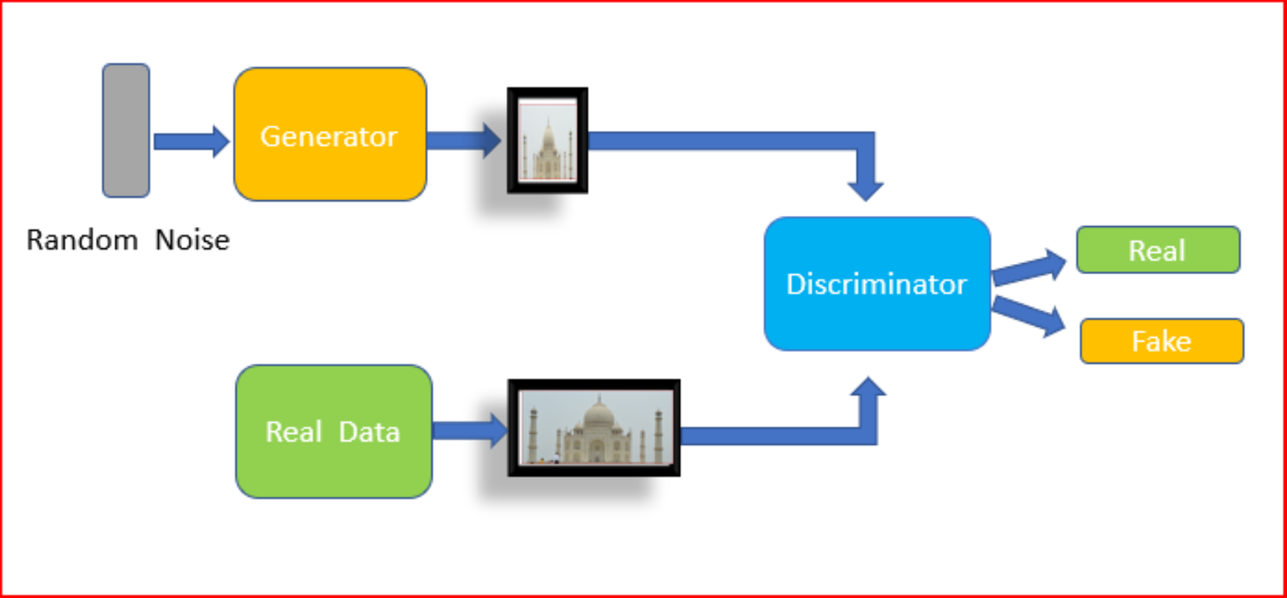
Conclusion & Recommendations

Slide 21
Building Image Pairs
Image pairs were created by mapping each of the genuine signatures by each individual against every other signature by the same individual (genuine + forgery). For example if individual 001 has 10 signatures in the training file, 5 genuine, 5 forgery. each genuine signature will be mapped 9 times with the other 9 signatures.
Image 1 | Image 2 | Train Label
062/09_062.png | 062_forg/01_0109062.PNG | 1

Slide 22
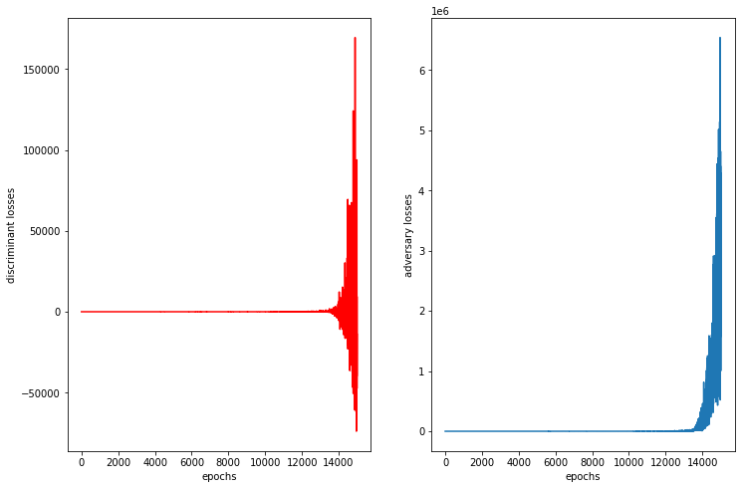
PATIENT MEDICAL HISTORY
2021
2023
2022
Age | 47 years old | Diseases | None
Gender | Woman | Location | Spain
Venus has a beautiful name
Mercury is a small planet
Mars is a very cold place

